Slide 1
IoT Applications in a Dental Practice
Sri Harsha Mahanti & Keerthi Raja

Slide 2
Mission Statement & Goals
“Our dental clinic has a mission of improving patient care satisfaction, efficiency of staff operations, and an increase in the overall net income with the use of IoT technology.”
Key measurable goals that have been established include:
-the reduction in patient wait times/consulting
-higher ratings seen through patient reviews
-positive cash flow statements.

Slide 3
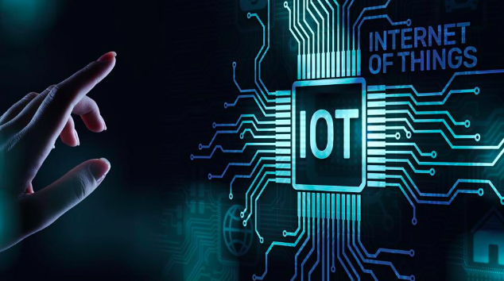
Motivation
- Research gate
-some of the chief complaints from dental patients include:
-long wait times
-quality of services
-use of old technology/methods
-and delays in diagnosis.
- Our practice will be utilizing various aspects of IoT technology to help address these complaints and have an overall smoother flow of operations.

Slide 4
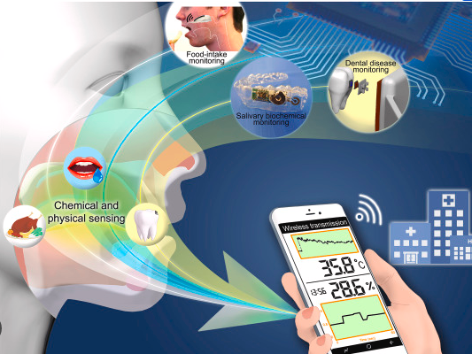
Application of IoT Technology
Sensors and Actuators
  Often work in tandem
  Sensors will be used for monitoring conditions
  Our sensors will signal to actuators when changes occur
  Actuators will perform actions based on what signals it receives
Sensors/Actuators our clinic will be utilizing:
  Temperature sensor
  Touch sensor
  Pressure sensor
  Electric actuator
  Linear actuator

Slide 5
Sensors
Temperature sensor
  Healthcare operating in a “post-covid” world
Pressure Sensor
  Pressure sensors will provide an automation that will determine the oxygen intake
Touch Sensor
  Upon entering the waiting room, patient will insert the key card into the provided slot.
  Notification sent to the tablets carried by the dental clinic staff.
  Will provide the staff with the patient’s information and electronic health records.
Notes:
Temperature sensor
Healthcare operating in a “post-covid” world
Placed at front desk kiosk, the patient’s first stop once entering the clinic
Sensor will register the patient’s temperature
Two main outcomes of temperature sensor:
-If sensor registers that the patient is in the safe zone-> kiosk will eject a key card and assign patient to a waiting room.
-If sensor registers that patient is NOT in the safe zone-> kiosk will direct them to a screen which will display upcoming available appointment dates and time and allow them to choose whichever works with their own schedule the most.
Pressure Sensor
In-clinic operations, such as extractions or root canals, will utilize anesthesia and oxygen machines.
Pressure sensors will provide an automation that will determine the oxygen intake needed for the patient as well as monitor their oxygen intake throughout the procedure.
Touch Sensor
Upon entering the waiting room, patient will insert the key card into the provided slot.
This touch sensor will immediately send a notification to the tablets carried by the dental clinic staff.
The notification will provide the staff with the patient’s information and electronic health records. The will also summarize the patient’s reason for visitation

Slide 6
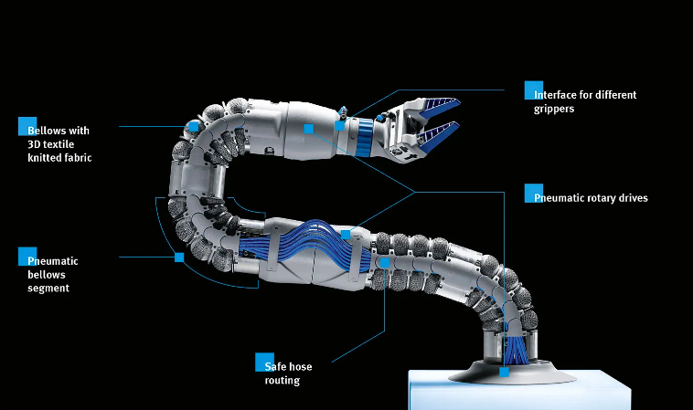
Actuators
Electric
  Found in our x-ray equipment
  Aids the machine in detecting cavities and other problem areas in a small amount of time
Linear
  Found in the patient chairs
  Help the doctor adjust the patient to different positions with the help of a touch sensor by his/her feet
  For convenience so he or she can operate the chair hands-free

Slide 7
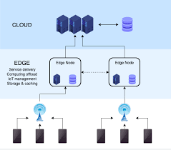
OT/IT Network
Data collected from sensors inside dental clinic from equipment analyzed and stored within the Edge and Cloud.
Success convergence leads to:
  Cost savings
  Higher satisfaction ratings
  Increase in operation standards and flexibility
Notes:
Convergence of OT/IT networks is necessary in establishing a tech-based future in our clinic.

Slide 8
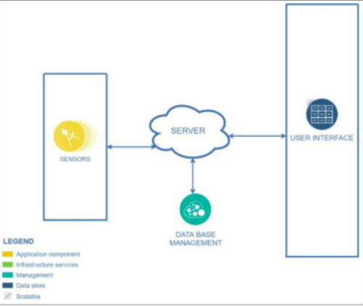
Architecture
A basic IoT system constitutes:
  the sensors
  cloud server
  database
  user interface
Example: Intraoral sensor
Edge vs. Cloud
IoT devices that will be used in our dental practice are typically used to monitor and transfer patient data to the cloud and edge for further analysis.

Slide 9
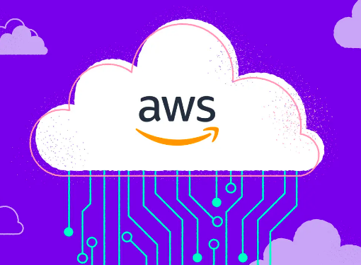
Cloud
Functions for the clinic include:
  Keep track of patient records
  Protection and security of data
  Employee tasks
  Flow of operations
Software-as-a-Service (SaaS)
  Cloud-based dental software
  Able to access information across multiple devices in various locations
  Cost savings
  Reliable and fast data management
  Improved security
Notes:
Keep track of patient records
f data
Employee tasks

Slide 10
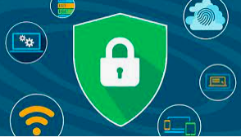
Data Security
Maintaining HIPAA (Health Insurance Portability and Accountability Act) regulations is our clinic’s priority
Cloud was created with safeguards to protect patient personal information
Safeguards include:
  Encryption of data
  2-factor authentication
  Built-in AWS cloud security

Slide 11
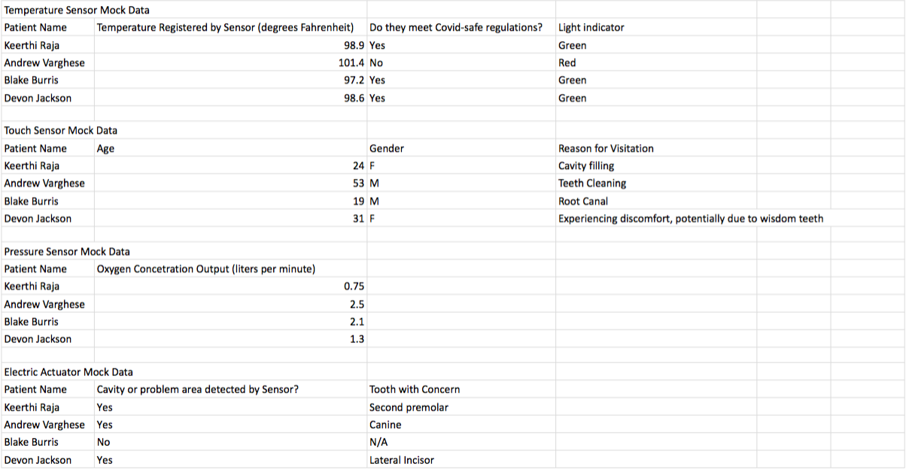
Data and Analysis

Slide 12
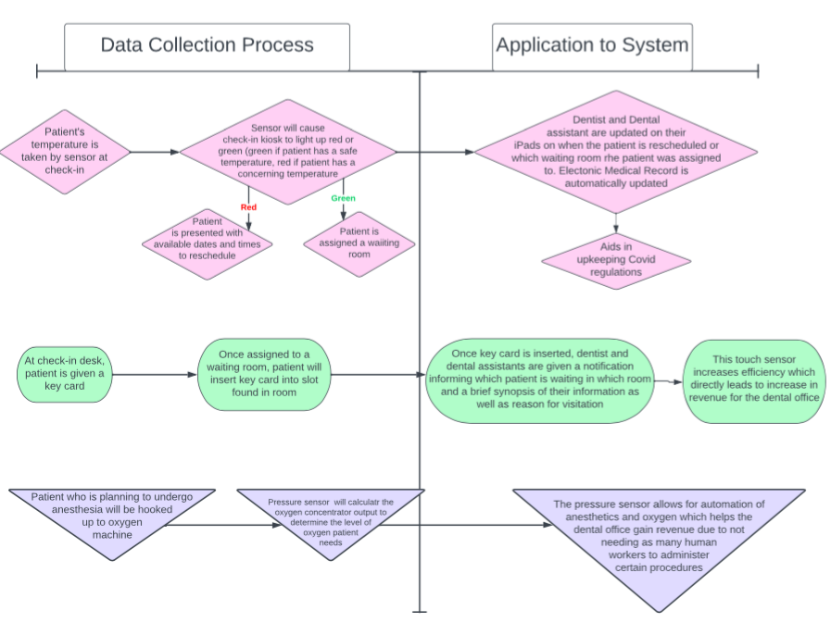
Data Integration

Slide 13
Business Value from IoT Data
Transformation of business design and evolution of equipment in the clinic
Derive more data for patients in a fraction of the time
Less human error occurrences
Create more time in daily schedules to see more patients
Overall increase in cash flow
Automation allows clinic to operate with less human staff members
Increased security of clinical records
Allow for patients to be more involved in their healthcare journey

Slide 14
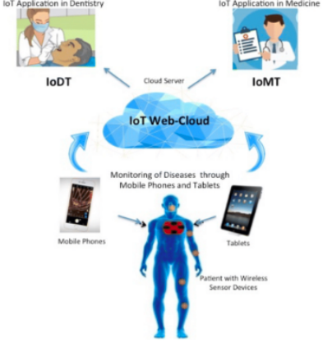
Discussion
Our goals with the use of IoT:
  Make going to the dentist as effortless and stress-free for our patients through automation
  Increase revenue for the clinic
  Protect and increase security of patient records
  Potentially expand business scope
  High satisfaction records
Potential roadblocks:
  Growing pains with the integration of IoT and altering business design
  Training staff and patients on how clinic will change in operations
  Some patients and staff members can be resistant to change
  Patients may feel a lack of personal connection

Slide 15
References
Balaji Ganesh S, & Sugumar, K. (2020). Internet of things—A novel innovation in Dentistry. Journal of Advanced Oral Research, 12(1), 42–48. https://doi.org/10.1177/2320206820980248
Engdahl, S. (2008). Blogs. Amazon. Retrieved November 30, 2022, from https://aws.amazon.com/blogs/architecture/building-event-driven-architectures-with-iot-sensor-data/
Internet of dental things (iodt), intraoral wireless sensors, and teledentistry: A novel model for prevention of dental caries. Home. (2021, June 7). Retrieved November 30, 2022, from https://www.researchsquare.com/article/rs-487495/v1
It - OT divide & solutions. bridging the IT healthcare technologies. Kontakt.io. (2022, April 6). Retrieved November 30, 2022, from https://kontakt.io/blog/bridging-the-it-ot-divide-in-healthcare/
Javaid, M., & Khan, I. H. (2021). Internet of things (IOT) enabled healthcare helps to take the challenges of covid-19 pandemic. Journal of Oral Biology and Craniofacial Research, 11(2), 209–214. https://doi.org/10.1016/j.jobcr.2021.01.015
Liu, L., Xu, J., Huan, Y., Zou, Z., Yeh, S.-C., & Zheng, L.-R. (2020). A smart dental health-IOT platform based on intelligent hardware, Deep Learning, and Mobile Terminal. IEEE Journal of Biomedical and Health Informatics, 24(3), 898–906. https://doi.org/10.1109/jbhi.2019.2919916
Nock, K. (n.d.). Linking in: The internet of things in the dental practice. Dental Products Report. Retrieved November 30, 2022, from https://www.dentalproductsreport.com/view/linking-in-the-internet-of-things-in-the-dental-practice
Salagare, S., & Prasad, R. (2021). Internet of dental things (iodt), intraoral wireless sensors, and teledentistry: A novel model for prevention of dental caries. https://doi.org/10.21203/rs.3.rs-487495/v1

